Slide 1
Book for the slides
1) Introduction to Data Mining
Author: P N Tan, M Steinbach and V Kumar
2) Data Mining: Concepts and Techniques
Author: J Han and M Kamber

Slide 2
Decision Tree Construction
Exponentially many decision trees can be constructed from a given set of attributes
Finding the optimal tree is computationally infeasible
Efficient algorithms have been developed to induce suboptimal decision trees
Hunt’s algorithm is the basis of many decision tree induction algorithms like ID3, C4.5, and CART
See Fig. 4.5

Slide 3
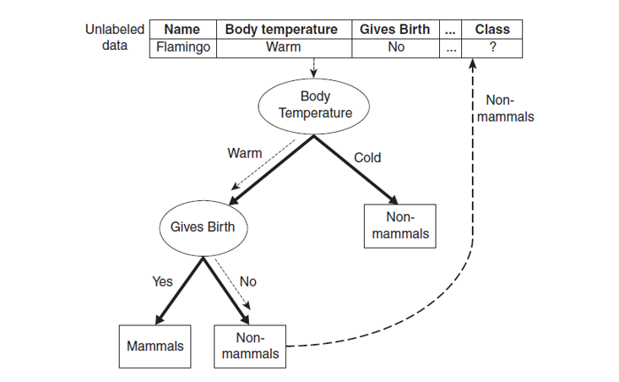

Slide 4
Hunt’s Algorithm
A decision tree is grown in a recursive fashion
Partitions the training records into successively purer subsets
The following variables are used:
    D_{t} = set of training records for node t
    Y = {y₁, y₂, …, y_{c}} are the class labels
See Fig. 4.6.
Hunt’s Algorithm
Step 1: If all the records in D_{t} belongs to the same class y_{t} then t is a leaf node labeled as y_{t}

Slide 5
Step 2: If D_{t} contains records that belong to more than one class, an attribute test condition is selected to partition the records into smaller subsets. A child node is created for each outcome of the test condition. The records in D_{t} are distributed to the children based on the outcomes. The algorithm is then recursively applied to each child node.
Design Issues for Decision Tree Induction
How should the training records be split?
  Each recursive step of the tree-growing process must select an attribute test condition to divide the records into smaller subsets.
How should the splitting procedure stop?
  A possible strategy is to continue expanding a node until either all the records belong to the same class or all the records have identical attribute values.

Slide 6
Methods of Expressing Attribute Test Condition
i) Binary attributes ii) Nominal attributes iii) Ordinal attributes iv) Continuous attributes
See Fig. 4.8
Algorithm for Decision Tree Induction
A skeleton decision tree induction algorithm called TreeGrowth is shown.
The algorithm consists of the training records E, and the attribute set F

Slide 7
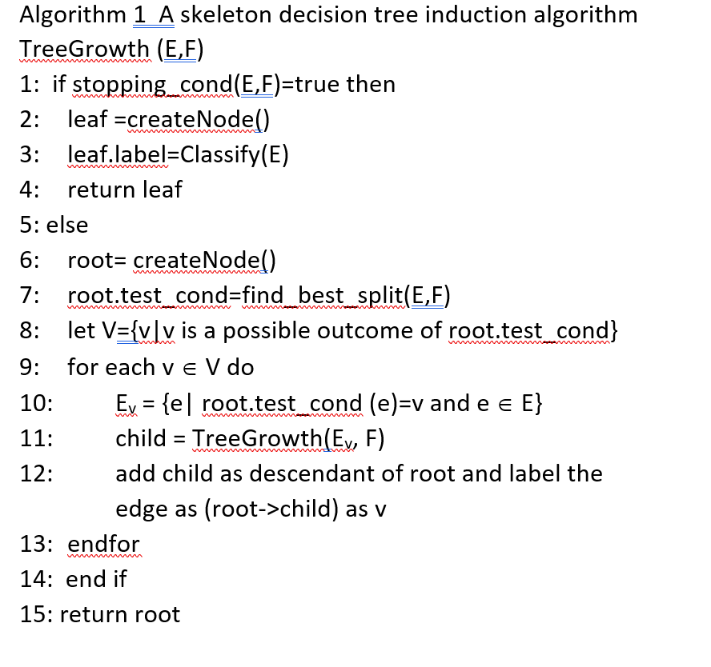

Slide 8
Four functions are used in this algorithm:
CreateNode(): It extends the decision tree by creating a new node. A node has either a test condition node.test_cond, or a class label node.label.
Find_best_split(): It determines which attribute should be used as a test condition for splitting the training records.
Classify(): It determines the class label to be assigned to a leaf node.
Stopping_cond(): It is used to terminate the tree growing process. It tests whether all the records have either the same class label or the same attribute values.

Slide 9
Tree Pruning
It is used to reduce the size of the tree
Overfitting
A model that fits the training data too well can have a poorer generalization error than a model with a higher training error, which is known as model overfitting.

